Slide 1
Battle of Neighborhoods Mumbai vs Delhi
Rupesh Yadav

Slide 2
Table Of Contents
Introduction : Business Problem
Data
Methodology
Results and Discussion
Conclusion

Slide 3
Introduction: Business Problem
Mumbai and Delhi are two metro cities of India. These two cities are crowded and always jam packed with people. These cities are one of the best tourist attractions. So, we will explore these two cities and try to find out which city has more venues to visit.
Nobody can remember or know all venues in Mumbai and Delhi area and so cannot promote all venues and categories which can found through Foursquare API.
We would also cluster the similar venues and categorize them to quickly find out which category of venues and areas are unique and have good parks and cafeterias.

Slide 4
Data
Helping Factors
Data Sources and operations
All venues of neighborhood
Top venue categories in neighborhood
Overall style for example cafes and parks and other places to visit
Data Found from the data.gov.in about the post offices in India
Extraction of the data about the required cities, Mumbai and Delhi
And using this data changed the office names as neighborhoods
All venues or neighborhood area through Foursquare API
After cleaning the data used the geopy python library
Geolocator to get coordinates of neighborhoods

Slide 5





Methodology
Collecting the Inspection Data
Explore and understand Data
Data Preparation and Preprocessing
Modeling
Results

Slide 6
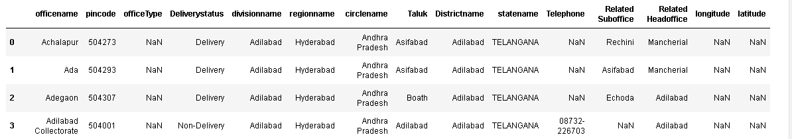
Methodology : Collecting Data
Data is collected from the data.gov.in
It contains some unnecessary columns, we will use officename column as neighborhood and regionname as region

Slide 7
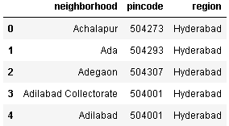
Methodology: Explore & Understand Data
Dropping all the unnecessary columns
Latitude and Longitude columns are also dropped since it contained NaN values.

Slide 8
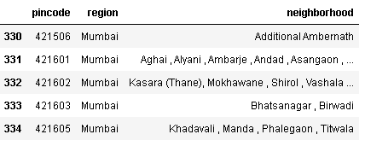
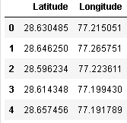
Methodology: Data Preparation and Preprocessing
After doing some processing on the data all the neighborhood that had same pincodes are joined separated by ‘ ,’.
For modeling phase both the cities are used separately, since it is a comparison between both the cities
Coordinates are calculated using googlemaps api
Now these two will be concatenated and create a final datframe
Final Dataframe is used for modeling phase

Slide 9
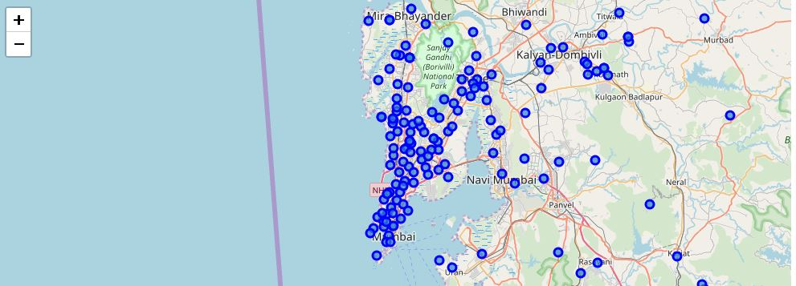
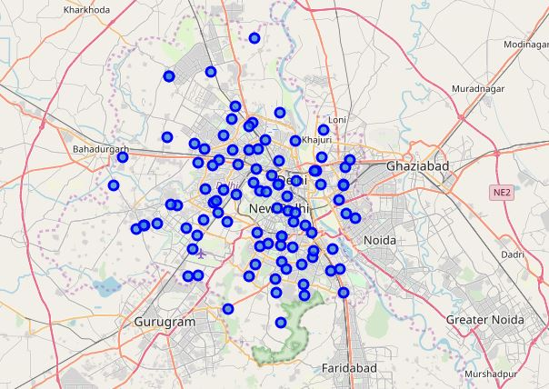
Methodology: Modeling
Mumbai and Delhi map with neighborhoods marked over it.
Using Folium library for geospatial plotting
Now by using Foursquare Api exploring the nearside venues under 500m radius
And then clustering of the neighborhoods will be done according to the similar venues and places

Slide 10
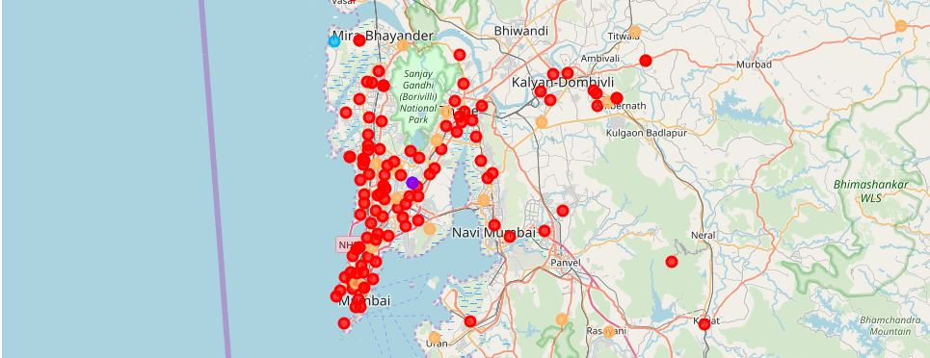
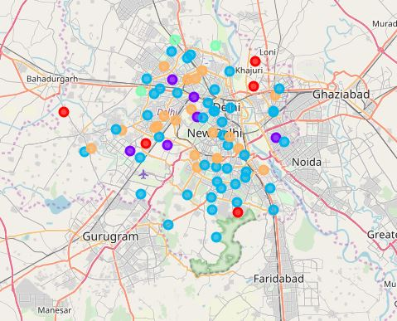
Results
We have clustered the neighborhoods based on the most common top venues in each of the neighborhood.
Given our cluster information for both Mumbai and Delhi, we see that Mumbai and its neighbourhoods are a great place for a foodie.
Delhi neighborhoods and good for those who like Arts and Crafts, Museums, Water Parks and Pizza places.

Slide 11
Conclusion
Thus, with this project, we have analyzed the kind of life each of these big metro cities has to offer based on the popular venues in their neighborhood.
Mumbai would be the choice if you are a foodie!
Another important aspect the study reveals is that the categories of venues Mumbai offers are far too many compared to Delhi. This means that Delhi becomes restrictive in terms of variety and convenience. With the data, we have studied Mumbai wins this battle of metros!

Slide 12
Thank You

